Slide 1
GSM Global System for Mobile Communications
Kiget Nicholas

Slide 2
GSM History

Slide 3
GSM Services
GSM was designed to do 3 things:
1. Bearer data services: Faxes, text messages, web pages.
Basic GSM had a basic data rate that is limited to 9.6 kbps
Extended by GMRS and EDGE to around 384 Kbps
2. Voice traffic
But, at a lower quality than analog.
3. Other features:
Call forwarding, caller id, etc…
Meaning, we need to connect to the SS7 network

Slide 4
GSM Architecture
Very similar to the analog architecture.
3 parts:
Mobile Phone
Digitizes and sends your voice.
Cell phone tower / Base Station
Controls the radio link.
Network switching system
The brains in the system.

Slide 5
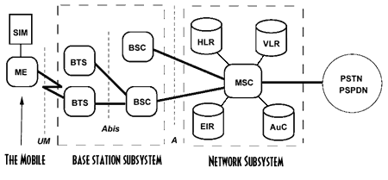
GSM Architecture
SIM – Subscriber Identity Module.
Allows you to switch phones.
Stores your phonebook and ringtones.
ME – Mobile Equipment.
Your cellphone
UM – User Mobile Frequency
The actual radio frequency you are using.

Slide 6
GSM Architecture
BTS – Base Transceiver Stations.
The radio antennas.
In GSM, 1 sends and 1 receives.
Only 2 are necessary.
BSC – Base Station Controller.
Packages up all the radio signals and sends them to the switch.
Handles handoffs and some other low-level functionality.
Manages up to 50 or so radio antennas
Provides better network segmentation.

Slide 7
GSM Architecture
MSC – Mobile Switching Center
Has several databases that perform call validation, call routing to the PSTN, and roaming validation.
Some of the databases:
HLR: Home Location Register
Main customer database
VLR: Visitor Location Register
Works in tandem with the HLR. Roamer database.
EIR: Equipment Identity Register
Deny stolen mobile phones service. Has all valid serials.
AuC: Authentication Center
Stores encryption keys necessary for secure communications.

Slide 9
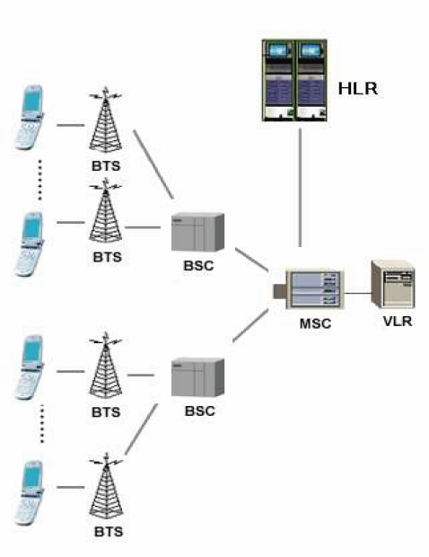
GSM Architecture

Slide 10
Radio Frequencies
Operates in the 1850 MHz band and from:
1850 to 1910 MHz Mobile to Base
1930 – 1990 MHz Base to Mobile
There are 300 forward/reverse channels in this band.
Each channel is 200 KHz
GSM uses TDMA to fit 8 conversations on a channel.
So, technically, GSM is TDMA and FDMA based.

Slide 11
GSM Burst Periods
Since GSM is TDMA based, it uses burst periods to make up a frame.
8 burst periods make up one frame.
A burst is like a slot in the train.
A burst period is where a phone gets to send digital information.
Phones send around 14 bits of information in every burst.
However, a burst period only lasts .577 ms.
Phones are only bursting information at around 1700 times a second, much less than the 8000 times a second a landline phone samples at.

Slide 12
GSM Frames
8 burst periods make 1 frame.
The frame length in time is 4.615 ms
.577 ms times 8
Each frame carries 164 bits
114 are for voice
The rest are for synchronization and CRC checks
Each frame can carry up to 8 voice samples, or, the frame can be dedicated to other necessary information.

Slide 13
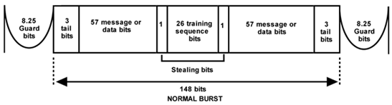
GSM Frames
Different frames mean different things.
For instance, this data structure contains information about the cell site.
The cell phone scans for this information when it is turned on.

Slide 14
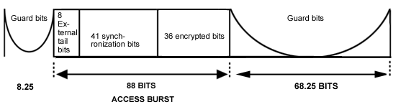
GSM Frames
This is the burst that occurs when the mobile transmits its access key back to the base station.

Slide 15
Speech Coding
GSM uses LPC – Linear Predictive Coding.
Uses interpolation.
Basically, previous samples, which don’t change very quickly, are used to predict current samples.
So, instead of actually sending the voice sample, the delta in the voice sample is sent.
Also, silence is not transmitted.
This increases throughput by about 40%.
This bits can be used for other conversations.

Slide 16
Digital Modulation
Uses Gaussian minimum shift keying.
Very complex, uses filters, phase shifts, and frequency shifts to actually send out binary digits.

Slide 17
Power Requirements
Since GSM is purely digital, it requires a lot less power since it doesn’t have to transmit an analog wave.
The maximum output power of a GSM phone is only 2 watts.
And this can be notched down by the controlling cell phone tower.
The minimum power is only 20 mW.

Slide 18
GSM Call Processing
Unlike AMPS, the cell tower can transmit on any of its frequencies.
The cell phone is actually pre-programmed in the SIM card to have a set of radio frequencies that it should check first.
When this fails, it needs to search through all frequencies.
When it detects the tower identifying itself, call processing begins.

Slide 19
SIM Card Secrets
The SIM card has a secret serial number that is only known by your cellular provider and the SIM card.
You, as the customer, do not know the number.
This secret number acts as a key, and it is 32 bits in length.

Slide 20
Authentication and Security
GSM uses a challenge/response public key setup.
The base station sends a random number to the mobile.
This acts as the base station’s public key.
The mobile then uses an algorithm called A3 to encrypt it’s secret key using the random public key that it was sent by the base station.
A5 is a derivative of DES.
Several rounds of shifts and XORs.

Slide 21
Authentication and Security
This encrypted information is then sent back to the base station.
The base station performs a reverse operation, and checks to see that the mobile sent the correct secret code.
If not, it is denied access.
A3 has proved to be very difficult to break.
Though, given a significant amount of time, it can be broken.

Slide 22
Authentication and Security
GSM also uses another database for security.
This database maintains a list of stolen cell phones, and cell phones that have technical errors.
These are also not allowed access to the digital network.

Slide 23
GSM conclusion
Widely used.
Upwards of 70% of phones.
Uses SIM cards so customers can use any phone and for security.
Allows more customers than analog.
Worse voice quality than analog.
Purely digital.
Open source, very complex standard.
Uses TDMA.
Will be replaced by CDMA in the near future.

